Slide 1
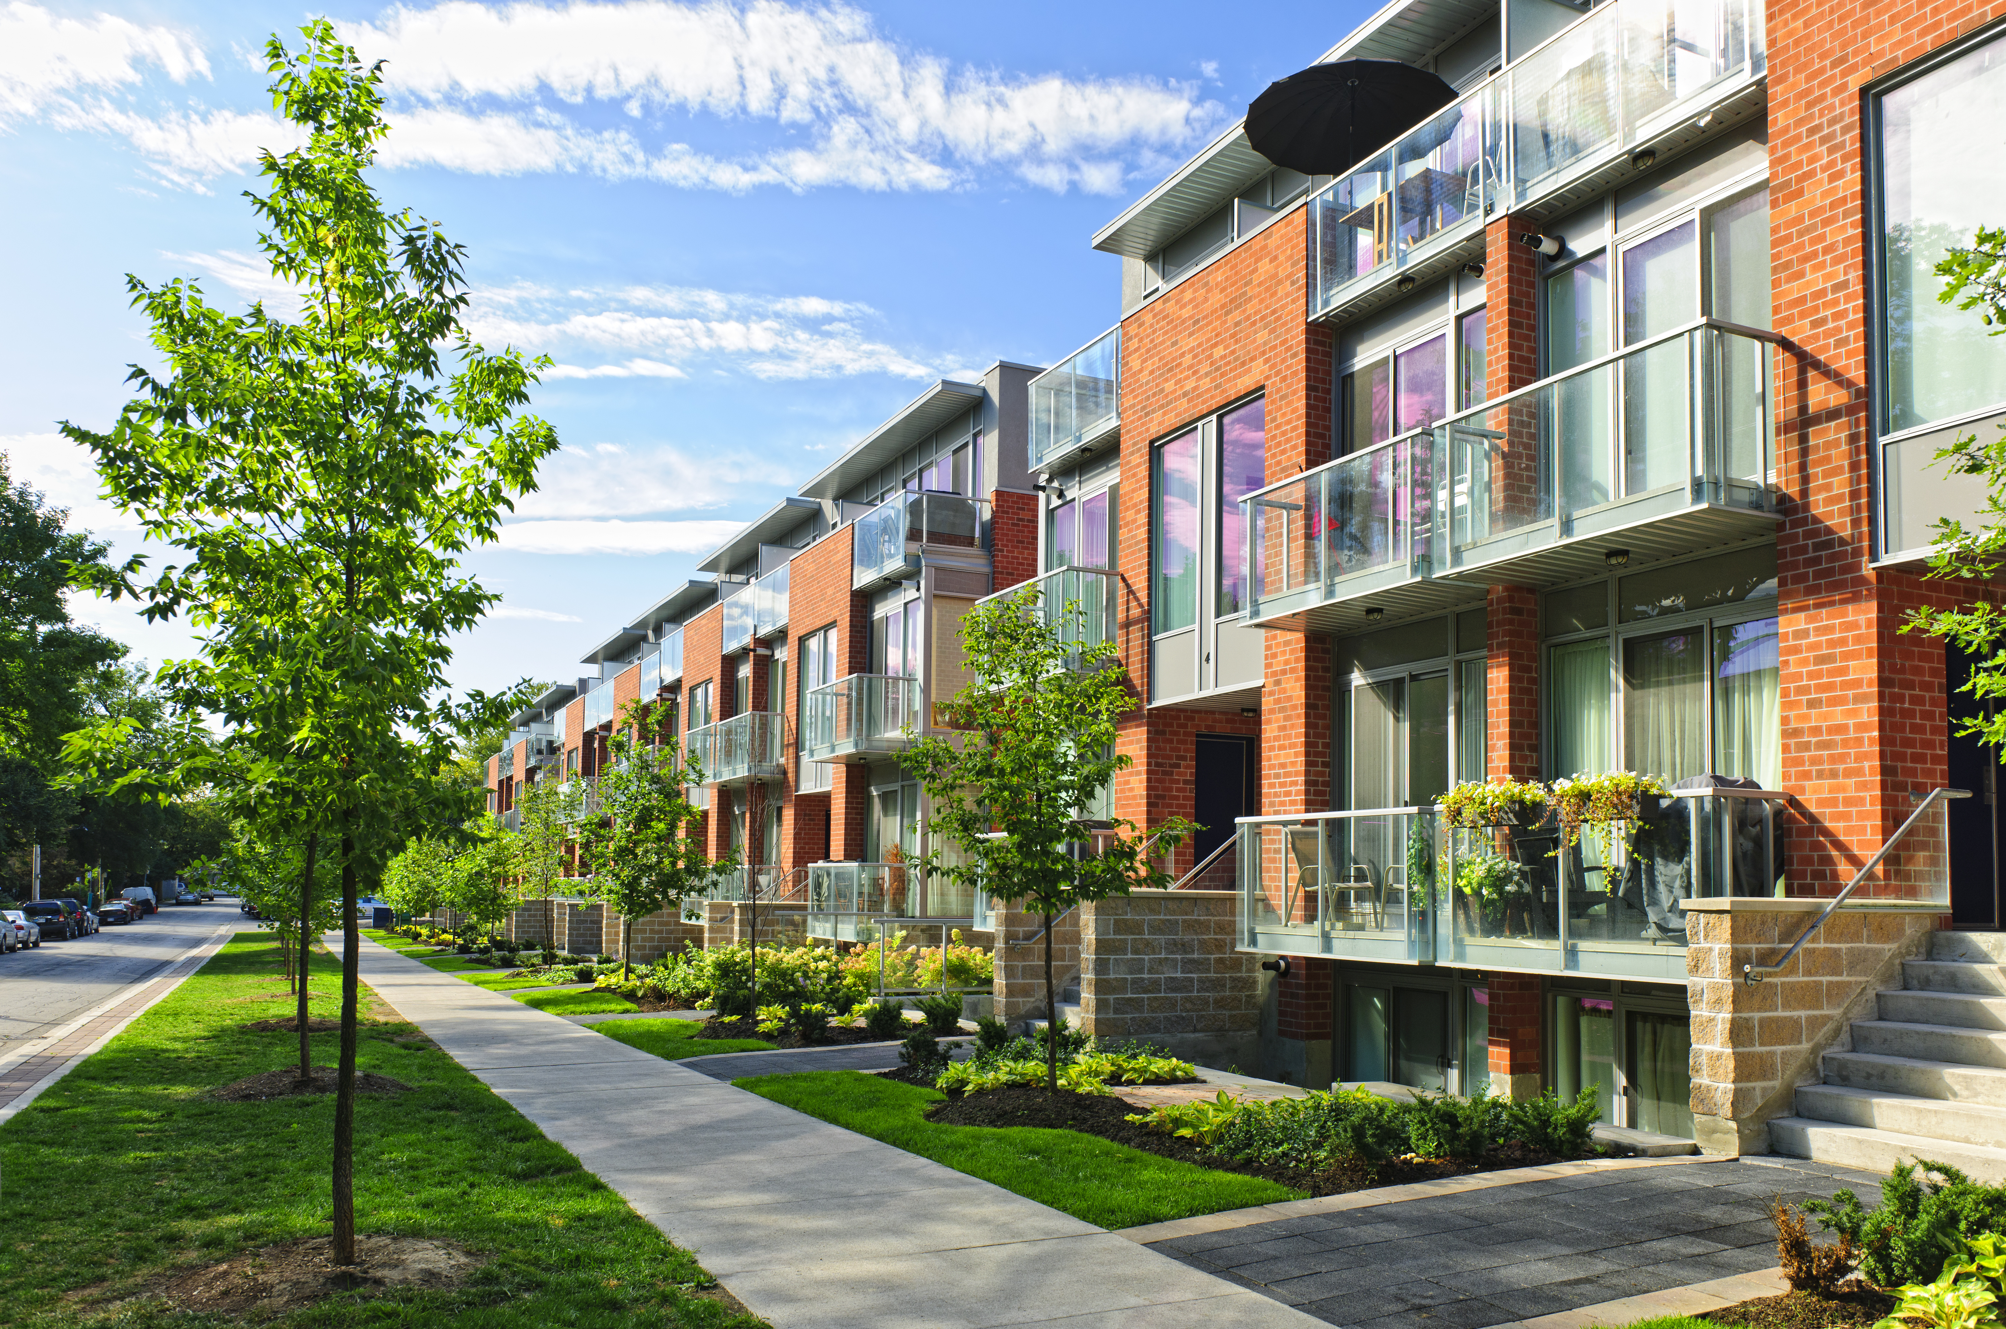







COLORADO
STARTER HOME INITIATIVE
HOUSING SUMMIT
SPONSORED BY:
FEATURING:

Slide 2


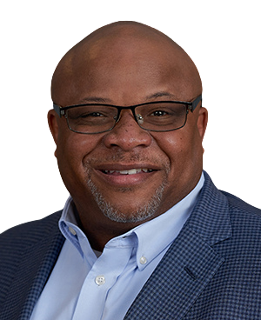
TYRONE ADAMS
PRESIDENT & CEO
COLORADO ASSOCIATION OF REALTORS
CSI COLORADO

Slide 3

KELLY CAUFIELD
EXECUTIVE DIRECTOR
COMMON SENSE INSTITUTE
CSI COLORADO

Slide 4
By the end of 2025 CSI will have....
  Completed over 200 reports on topics such as:
  Received close to 2,000 mentions in the media
  Housing affordability
  State Budget
  Financial Fraud
  CO’s Energy Future
  Wolf Reintroduction
  Water rights
  Migration
  Homelessness
Looking ahead to 2026...
CSI is in progress of authoring research in 16 states!
AZ, AR, CO, IA, IN, GA, KS, LA, MI, NH, OK, OR, TN, UT, WA, & WY

Slide 5
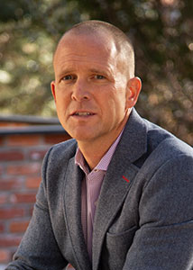


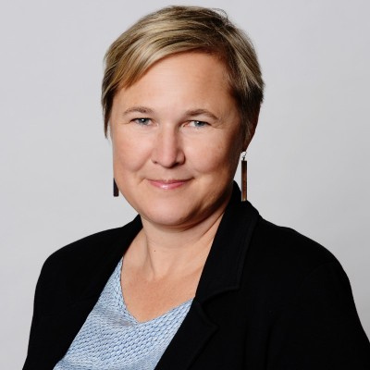
PANEL
JEFF HANDLIN
MIKE COOPER
SCOTT DERGANCE
AMY SCHWARTZ
Oread Capital
Boulder Creek
KGA Studio Architects
Oakwood Homes
Moderator

Slide 6
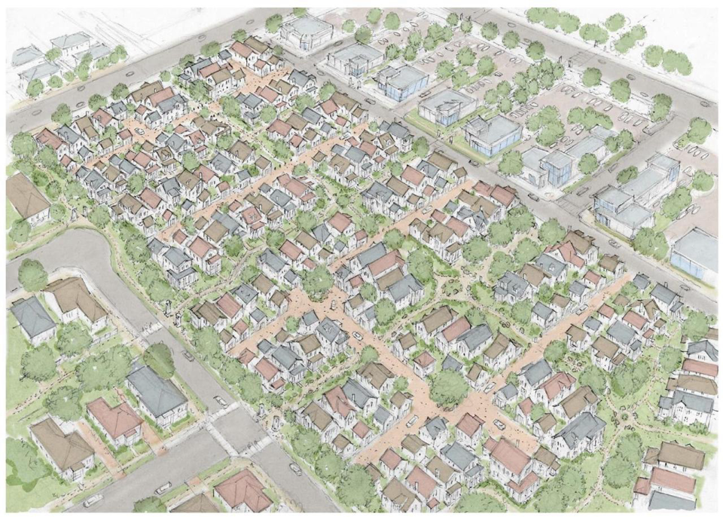

Slide 7
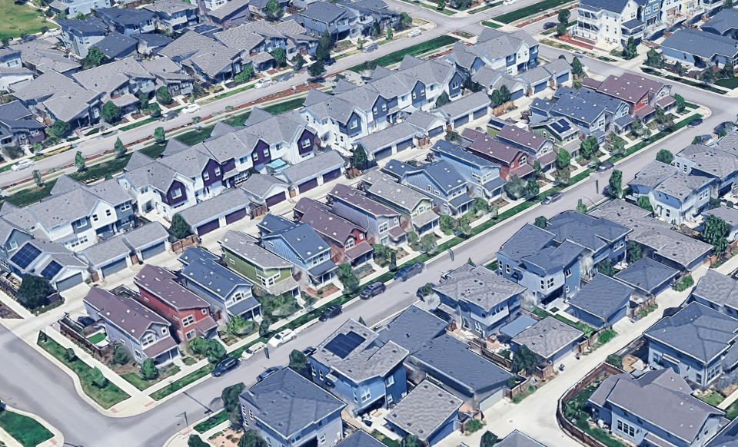

Slide 8
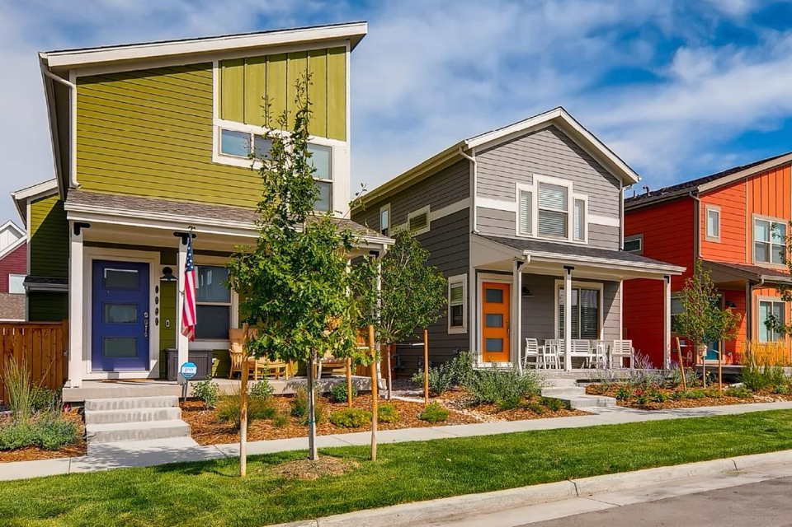

Slide 9
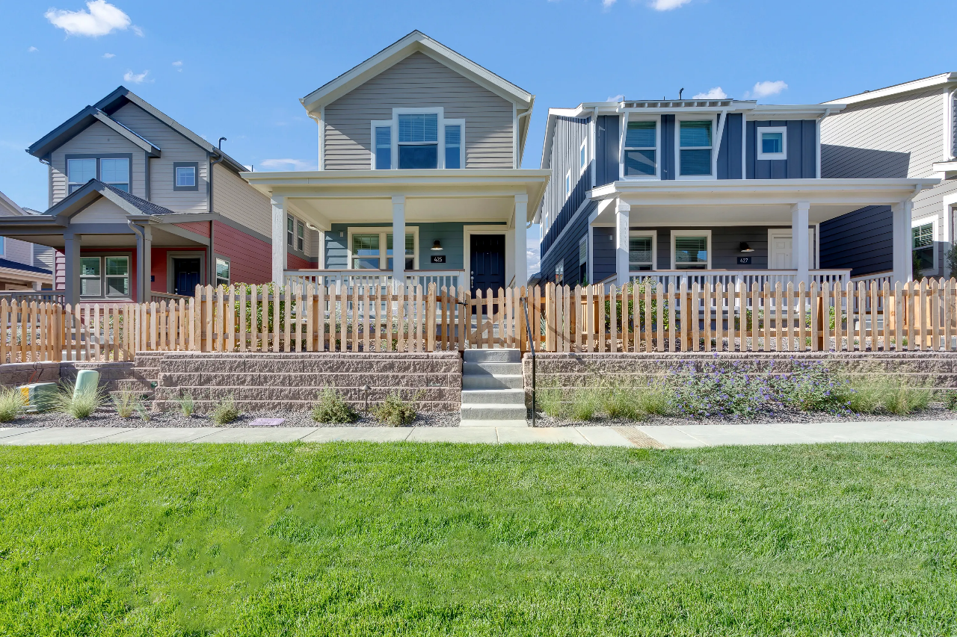

Slide 10
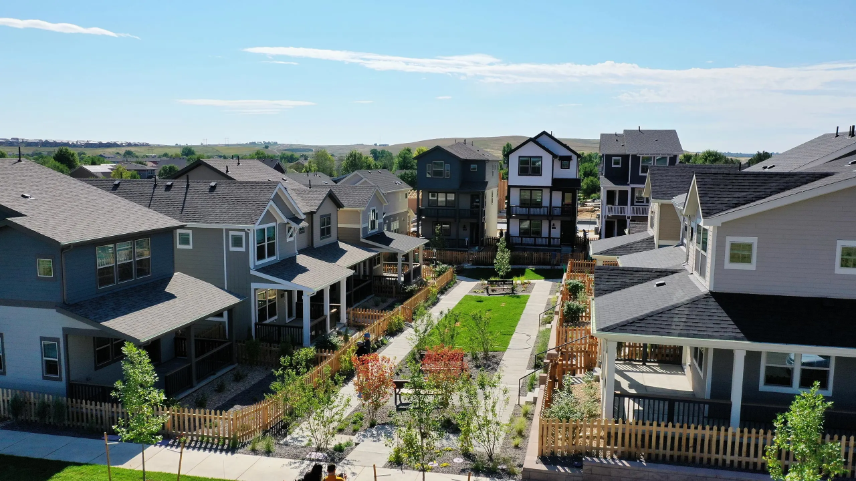

Slide 11
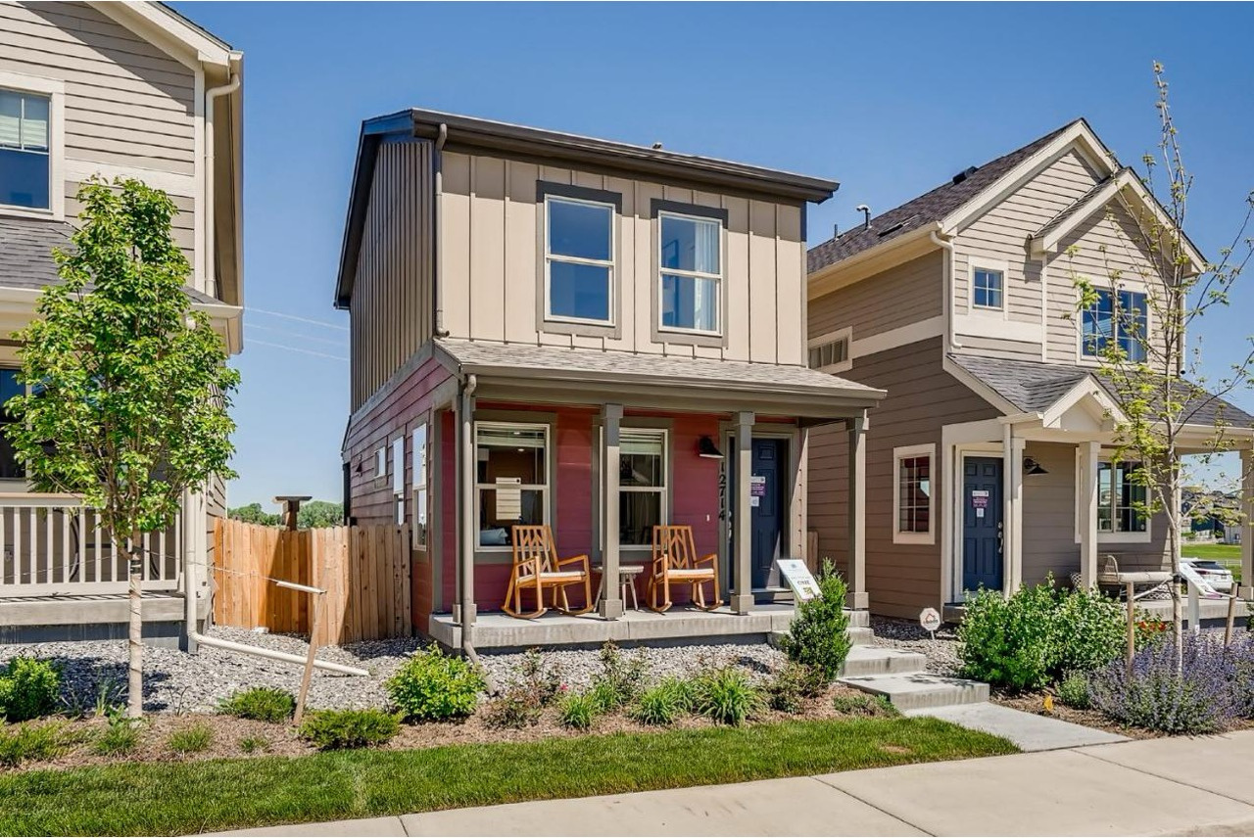

Slide 12
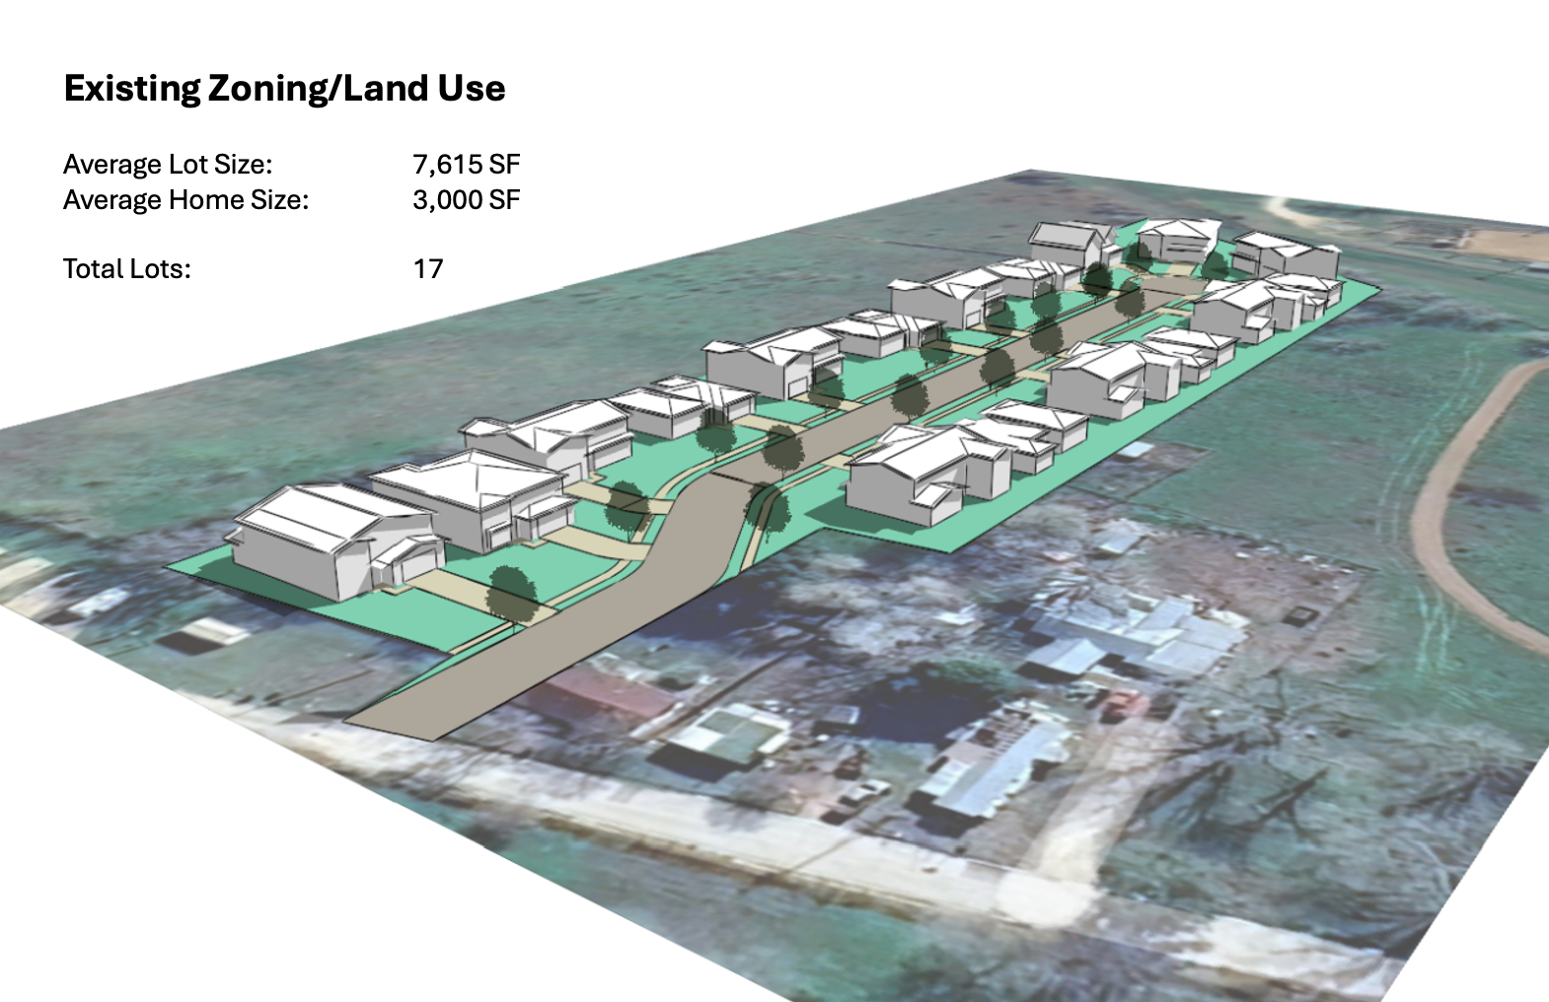

Slide 13
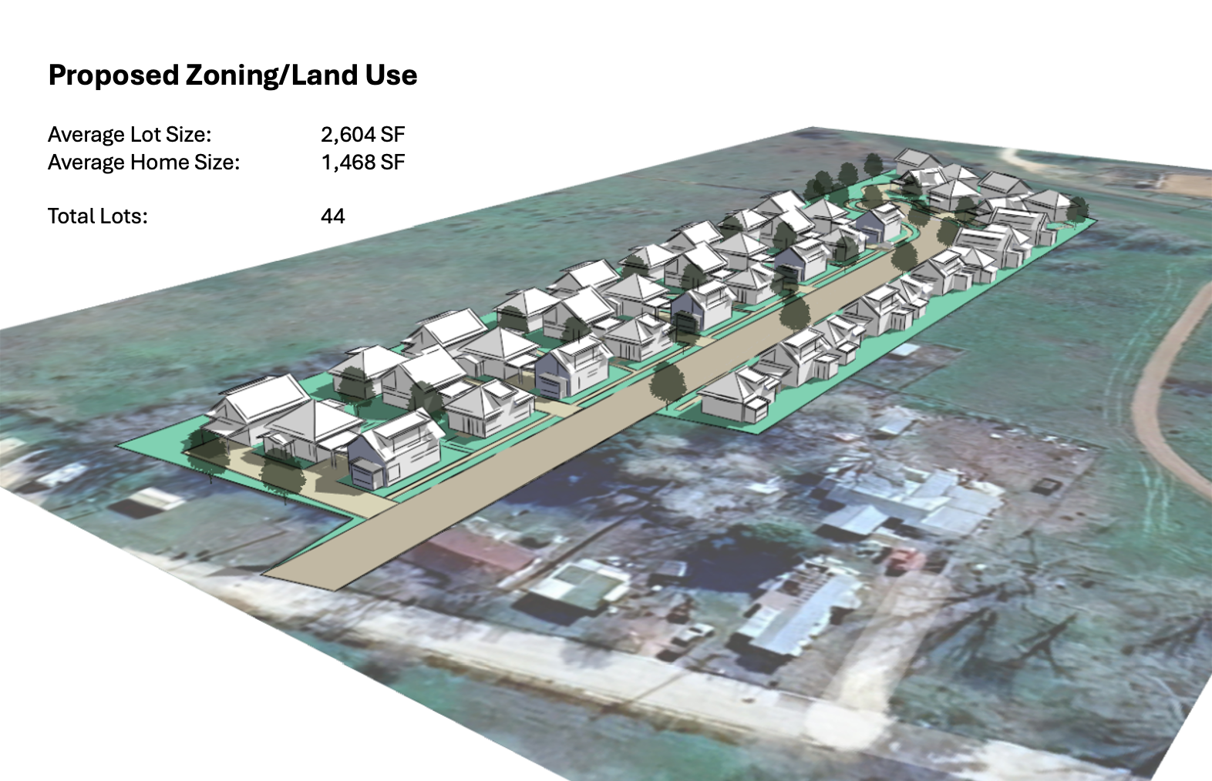

Slide 14
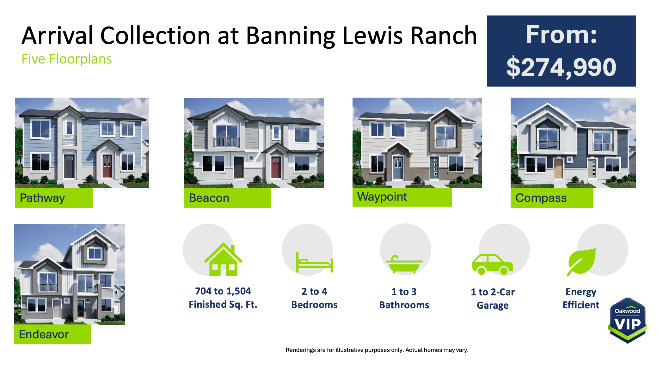

Slide 15
PANEL
JEFF HANDLIN
MIKE COOPER
SCOTT DERGANCE
AMY SCHWARTZ
Oread Capital
Boulder Creek
KGA Studio Architects
Oakwood Homes
Moderator

Slide 16
KELLY CAUFIELD
EXECUTIVE DIRECTOR
COMMON SENSE INSTITUTE
CSI COLORADO

Slide 17


DON ELLIOTT
SENIOR ZONING CONSULTANT
CSI COLORADO

Slide 18
The Assignment
  Draft a simple, flexible zoning template to allow and encourage the construction of small, single-family, detached houses on small individual lots in rural areas and growing outskirts of urban areas.
2. Show how and where the template may need to be modified to:
  Integrate with different types of local zoning controls (like form-based codes and integrated development codes)
  Address other types of starter homes (like duplexes, triplexes, or cottage developments)
  Work in other contexts (like urban areas, inner suburbs, mountain communities and resorts)

Slide 19
The Structure of the Template
  Purpose
  Single-Family Starter Home (R-SH) Zoning District
  Site Location and Dimensional Standards
  Building Design and Development Standards
  Administrative Approval for Starter Home Developments
  Definitions

Slide 20
The Basics
  Could be a stand-alone chapter – or integrated
  These types of Starter Homes could be added to existing zones
  Some sections marked as [OPTION] which means:
    I think they reflect good zoning practice, and
    It is good to have a reasonable text in hand.

Slide 21
Starter Home Zoning District
  Primary and accessory land uses:
    Small single-family detached homes (1,000 sq. ft. max)
    Some civic / community open space uses
    Internal ADU (HB24-1152)
    [OPTION] External ADU
  [OPTION] Maximum size limit of a Starter Home development

Slide 22
Site Location and Dimensional Standards
  Minimum lot area = 1,000 sq. ft. plus any area needed to meet fire/safety/drainage codes
  Minimum lot sizes can be averaged
  Some open space can be provided nearby
  [OPTION] Multiple starter homes may be located on a single platted lot

Slide 23
Building Design & Development Standards
  Maximum height = 38 feet
  Minimum front setback = 5 feet (15 for front garage)
  Minimum side and rear setbacks = those required by building/fire/ drainage standards and codes
  Minimum dwelling size = local IRC
  [OPTION] Defined building form for form-based code communities

Slide 24
Building Design & Development Standards
  No on-site parking required
  [OPTION] Street frontage trees required (1/35 feet)
  [OPTION] Maximum occupancy based on IPMC
  [OPTION] No more than three identical home facades in a row on any single block face.

Slide 25
Administrative Approvals
  Following rezoning and subdivision, all approvals are administrative.
  Decision within 90 days
  Conditions on approvals limited to those needed to comply with adopted standards
  Director has authority to approve applications that are “close enough”

Slide 26
Guidance on Tailoring
Blue boxes indicate those sections of the template that will need to be modified to address other types of Starter Homes (like duplexes, triplexes, and cottage developments)
Green boxes indicate those sections of the template that will need to be modified to address different development contexts (like urban areas, inner suburbs, mountain communities and resorts
duplexes, triplexes, and cottage developments)

Slide 27

Q
A
&
Any questions for Don?

Slide 28
BREAK

Slide 29
KELLY CAUFIELD
EXECUTIVE DIRECTOR
COMMON SENSE INSTITUTE
CSI COLORADO

Slide 30
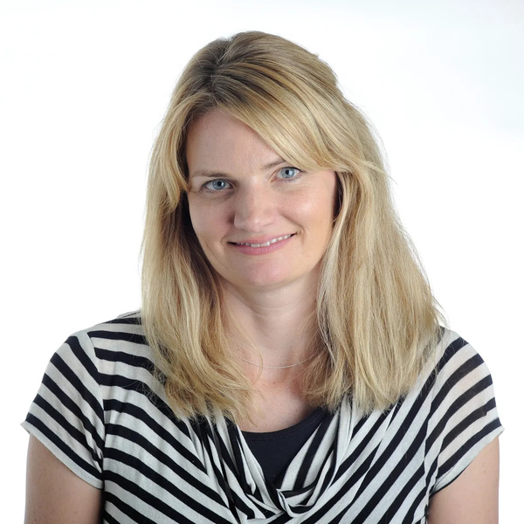
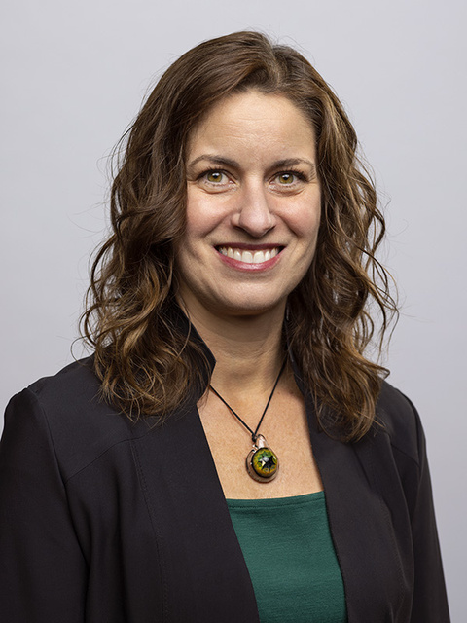
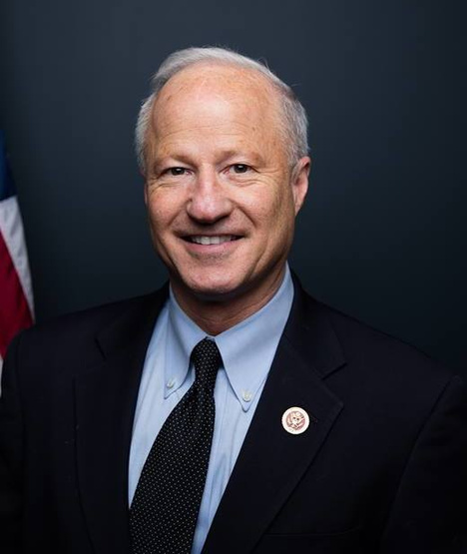

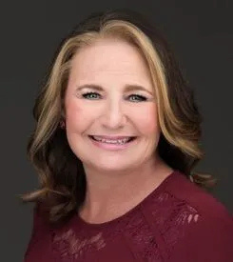
PANEL
JEN BROWN
MAYOR LAURA WEINBERG
MAYOR MIKE
COFFMAN
PETER LIFARI
HEIDI WILLIAMS
Colorado Sun
City of Golden
City of Aurora
CSI Housing Fellow
Civic Results
Moderator

Slide 31
REGIONAL
BREAKOUT SESSIONS

Slide 32
ADAMS – ARAPAHOE: PETER LIFARI
DENVER: HEIDI WILLIAMS
JEFFERSON – DOUGLAS: DJ SUMMERS
COLORADO SPRINGS: MARLA NOVAK
STATEWIDE: DON ELLIOTT
NORTHERN COLORADO: BROOKE CUNNINGHAM
OUT OF STATE: ALYSSA ZAMBRANO
OTHER COLORADO REGIONS: COLE ANDERSON

Slide 33
KELLY CAUFIELD
EXECUTIVE DIRECTOR
COMMON SENSE INSTITUTE
CSI COLORADO

Slide 34

SUPPORT FACTS-BASED POLICY RESEARCH

Slide 35
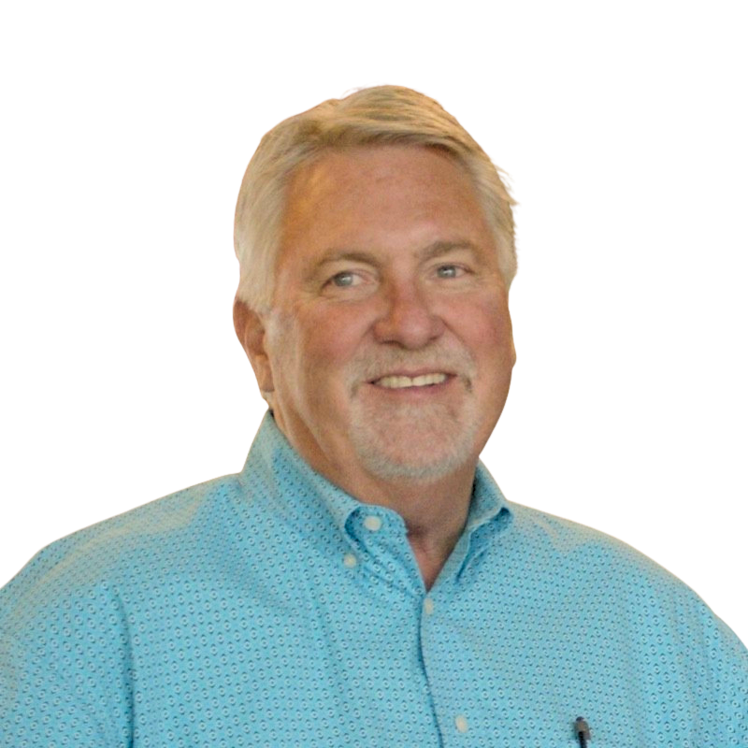
JOE O’DEA
CEI CONSTRUCTORS INC.
CSI COLORADO

Slide 36
THANK YOU
for joining us!

